Slide 1
Student Retention & Graduation Equity in Higher Education
A Data-Driven Analysis Using IPEDS Data | Round 2 Presentation
April 13, 2026
Hemanth Kumar Konda
Position Applied: Data Analyst & Assessment Specialist
Notes:
Good afternoon, everyone. My name is Hemanth Kumar Konda and today I'm here to present my analysis on student retention and graduation equity at the University of Louisiana at Lafayette. Student Retention is nothing but a school's ability to keep students enrolled from year to year until they graduate. Graduation Equity means ensuring every student has a fair chance to graduate.

Slide 2
The Challenge
Student Retention & Graduation Equity
Higher education institutions nationally face declining retention and completion rates.
Students who leave before graduating represent lost potential — for themselves and the institution.
Equity gaps in graduation outcomes indicate systemic barriers for specific student populations.
Data-driven institutions that identify these gaps early can intervene proactively.
The question is not whether gaps exist — it is whether we are measuring them clearly enough to act on them.
Notes:
Now my reason to taking this as problem statement - Across the country, colleges are struggling to keep students enrolled and get them across the finish line. When a student leaves without a degree, everybody loses — the student loses future earnings, the university loses tuition, and the community loses a skilled graduate. The real question is not whether these gaps exist. We know they do. The question is — are we measuring them clearly enough to do something about it? That is exactly what this analysis tries to answer.

Slide 3
How I Collected and Curated the Data
Data Source: IPEDS — Integrated Postsecondary Education Data System (U.S. Department of Education)
Datasets Used:
Fall 2024 Enrollment — headcount by gender, race/ethnicity, age, distance education, residency
Spring 2024-25 Retention — first-to-second year retention rates by enrollment intensity
Winter 2024-25 Graduation Rates — by timeline, gender, race/ethnicity, and financial aid status
Data Cleaning Steps:
Extracted structured tables from raw IPEDS flat files
Removed metadata rows and standardized column headers
Calculated estimated counts from percentage fields
Structured into 6 fact tables for Power BI modeling
Tool: Power BI Desktop
Notes:
Now, where did the data come from? I used IPEDS — that stands for Integrated Postsecondary Education Data System. Think of it as the federal government's official report card for every college in America. Every university is required to submit data to IPEDS every year. I pulled three specific datasets — enrollment numbers, retention rates, and graduation rates. I then cleaned that raw data, organized it into a structured format, and loaded it into Power BI to build the dashboard you're about to see.

Slide 4
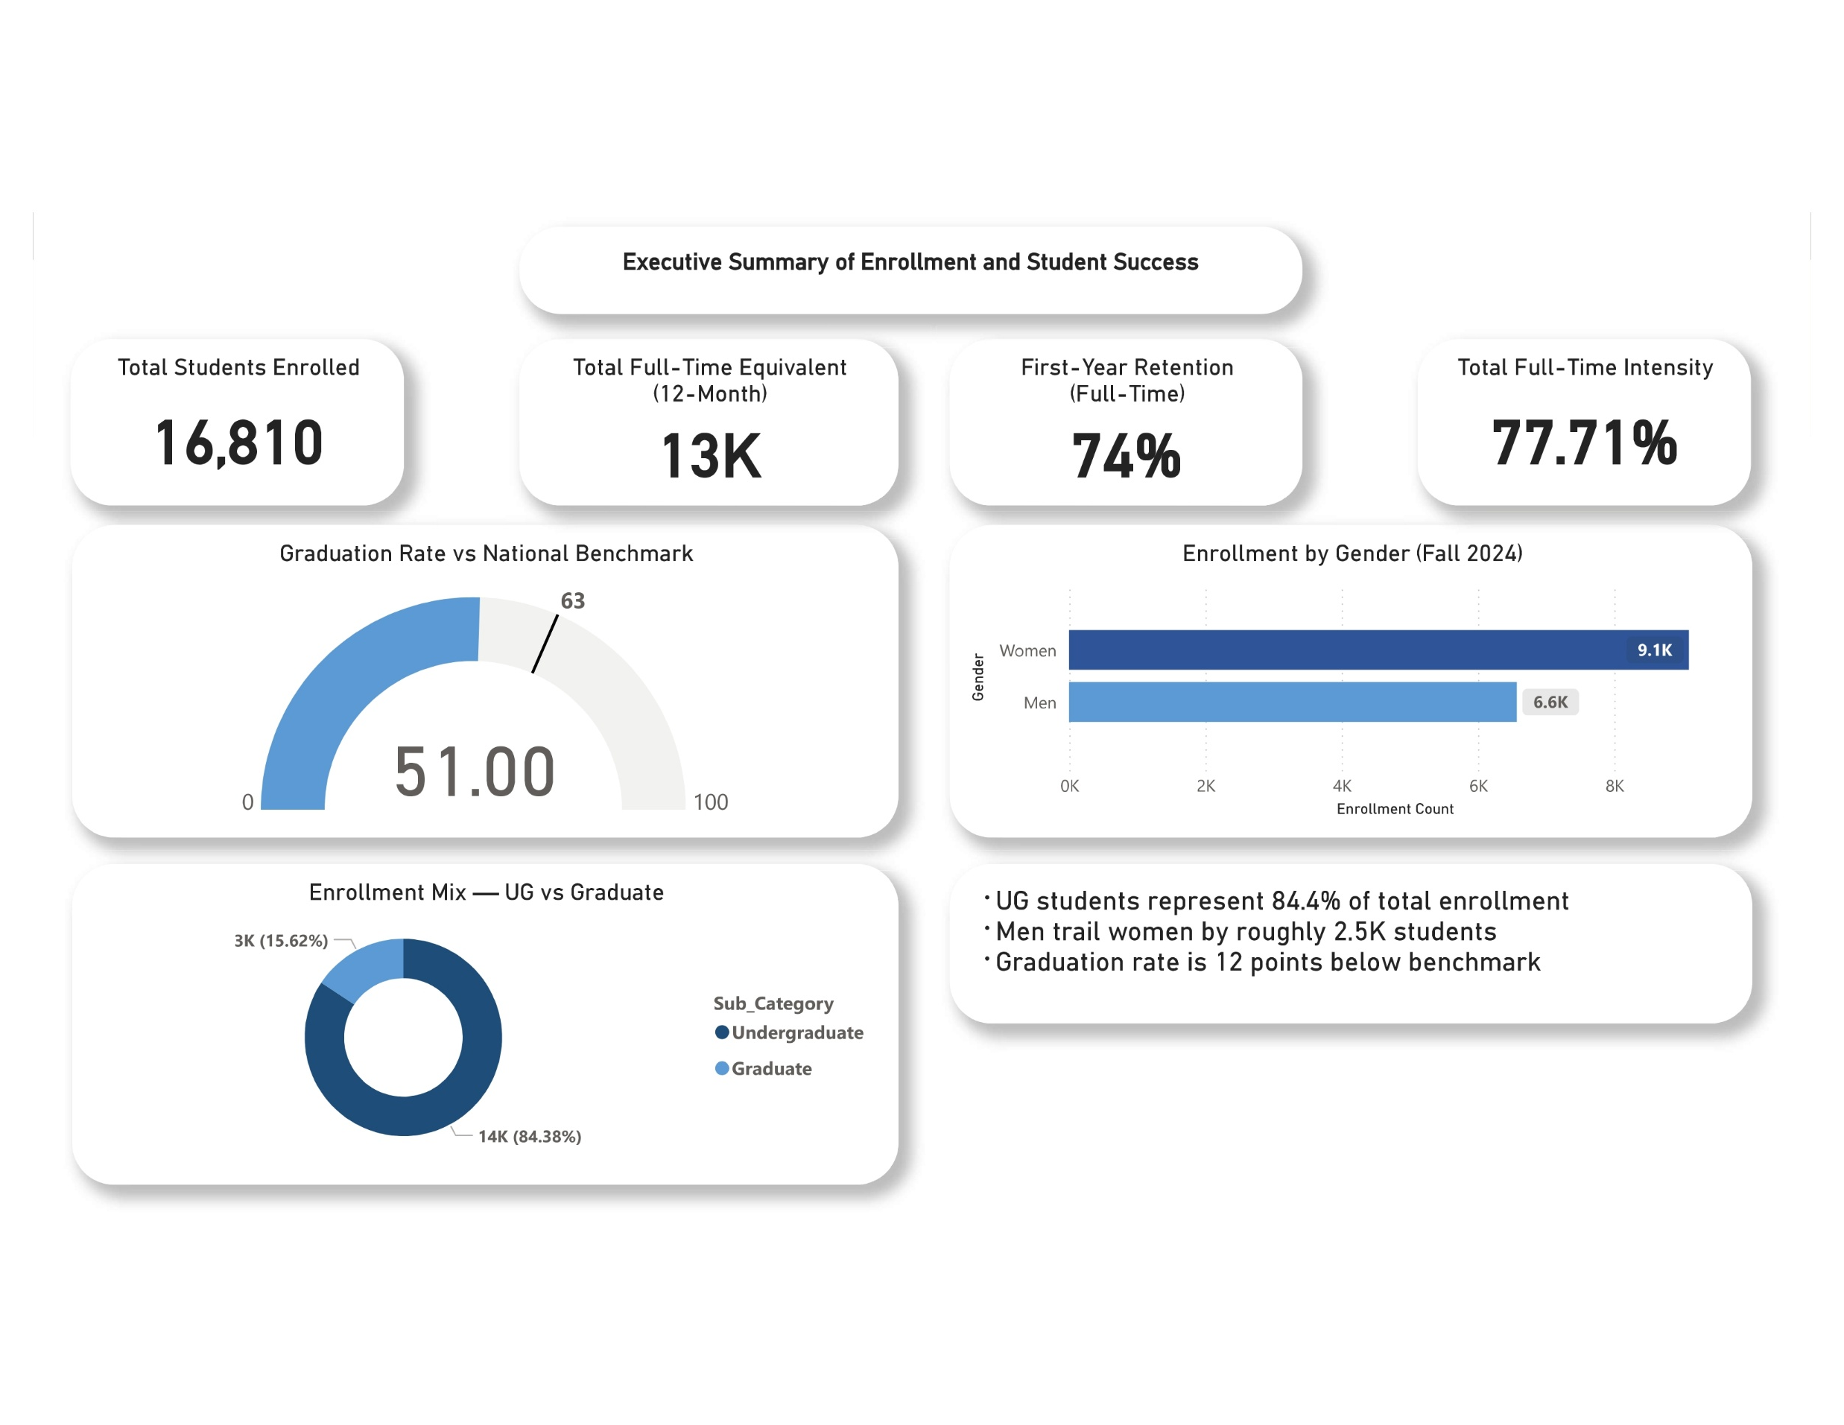
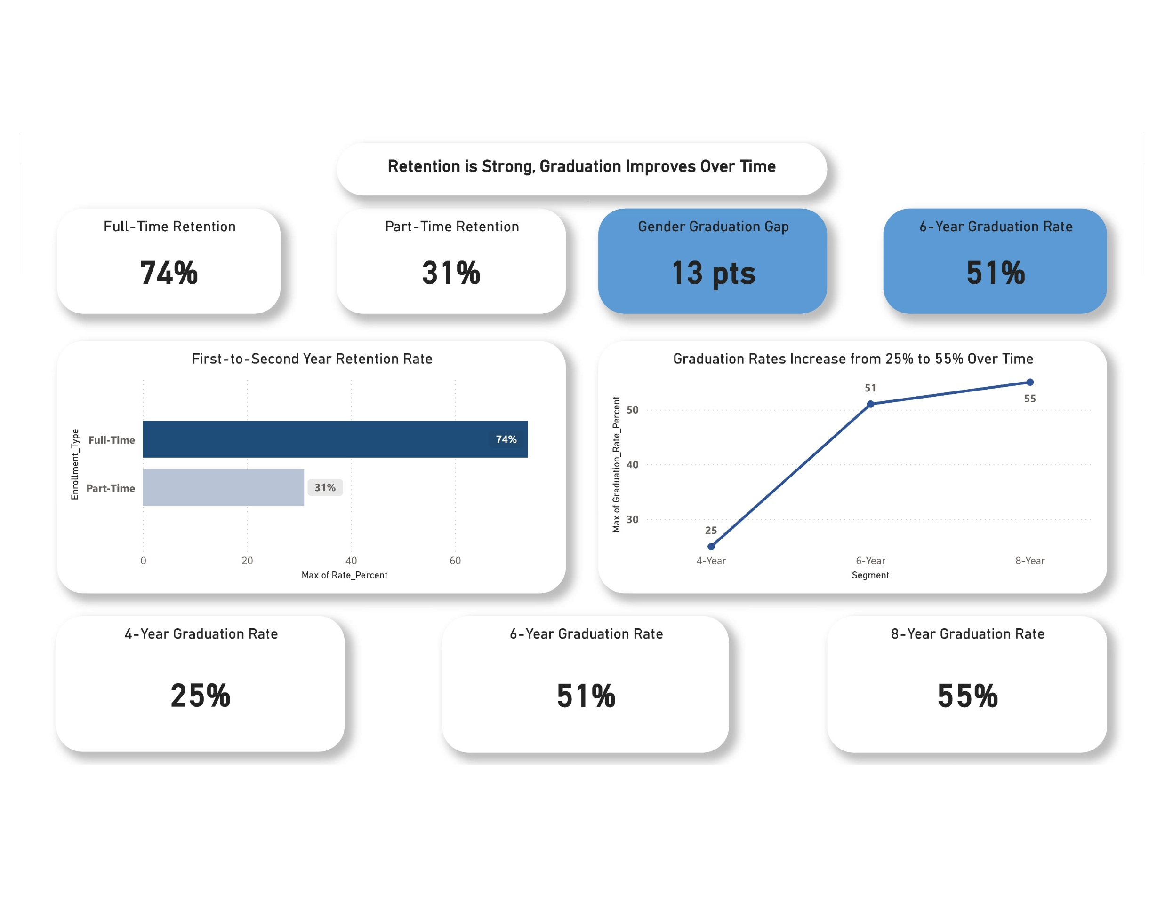
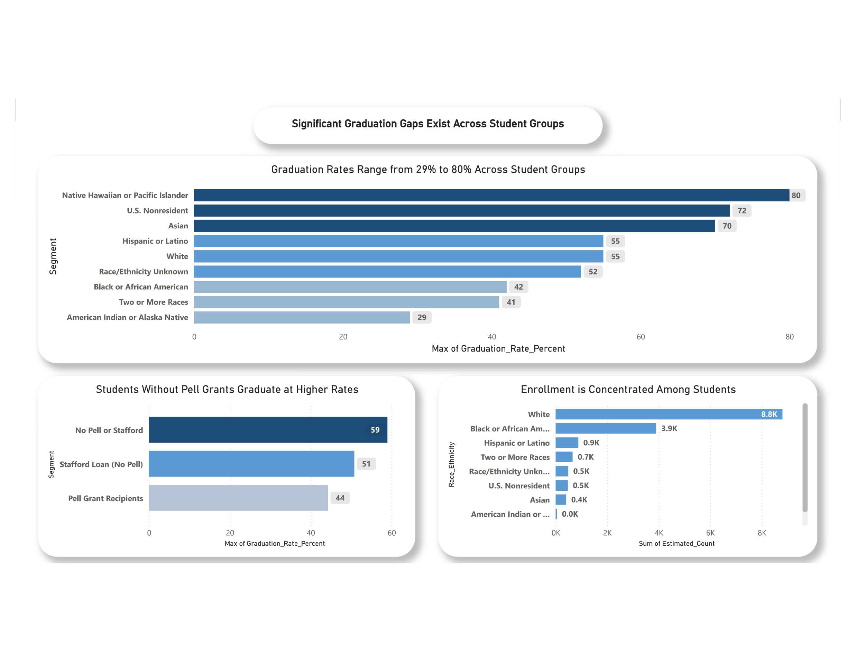
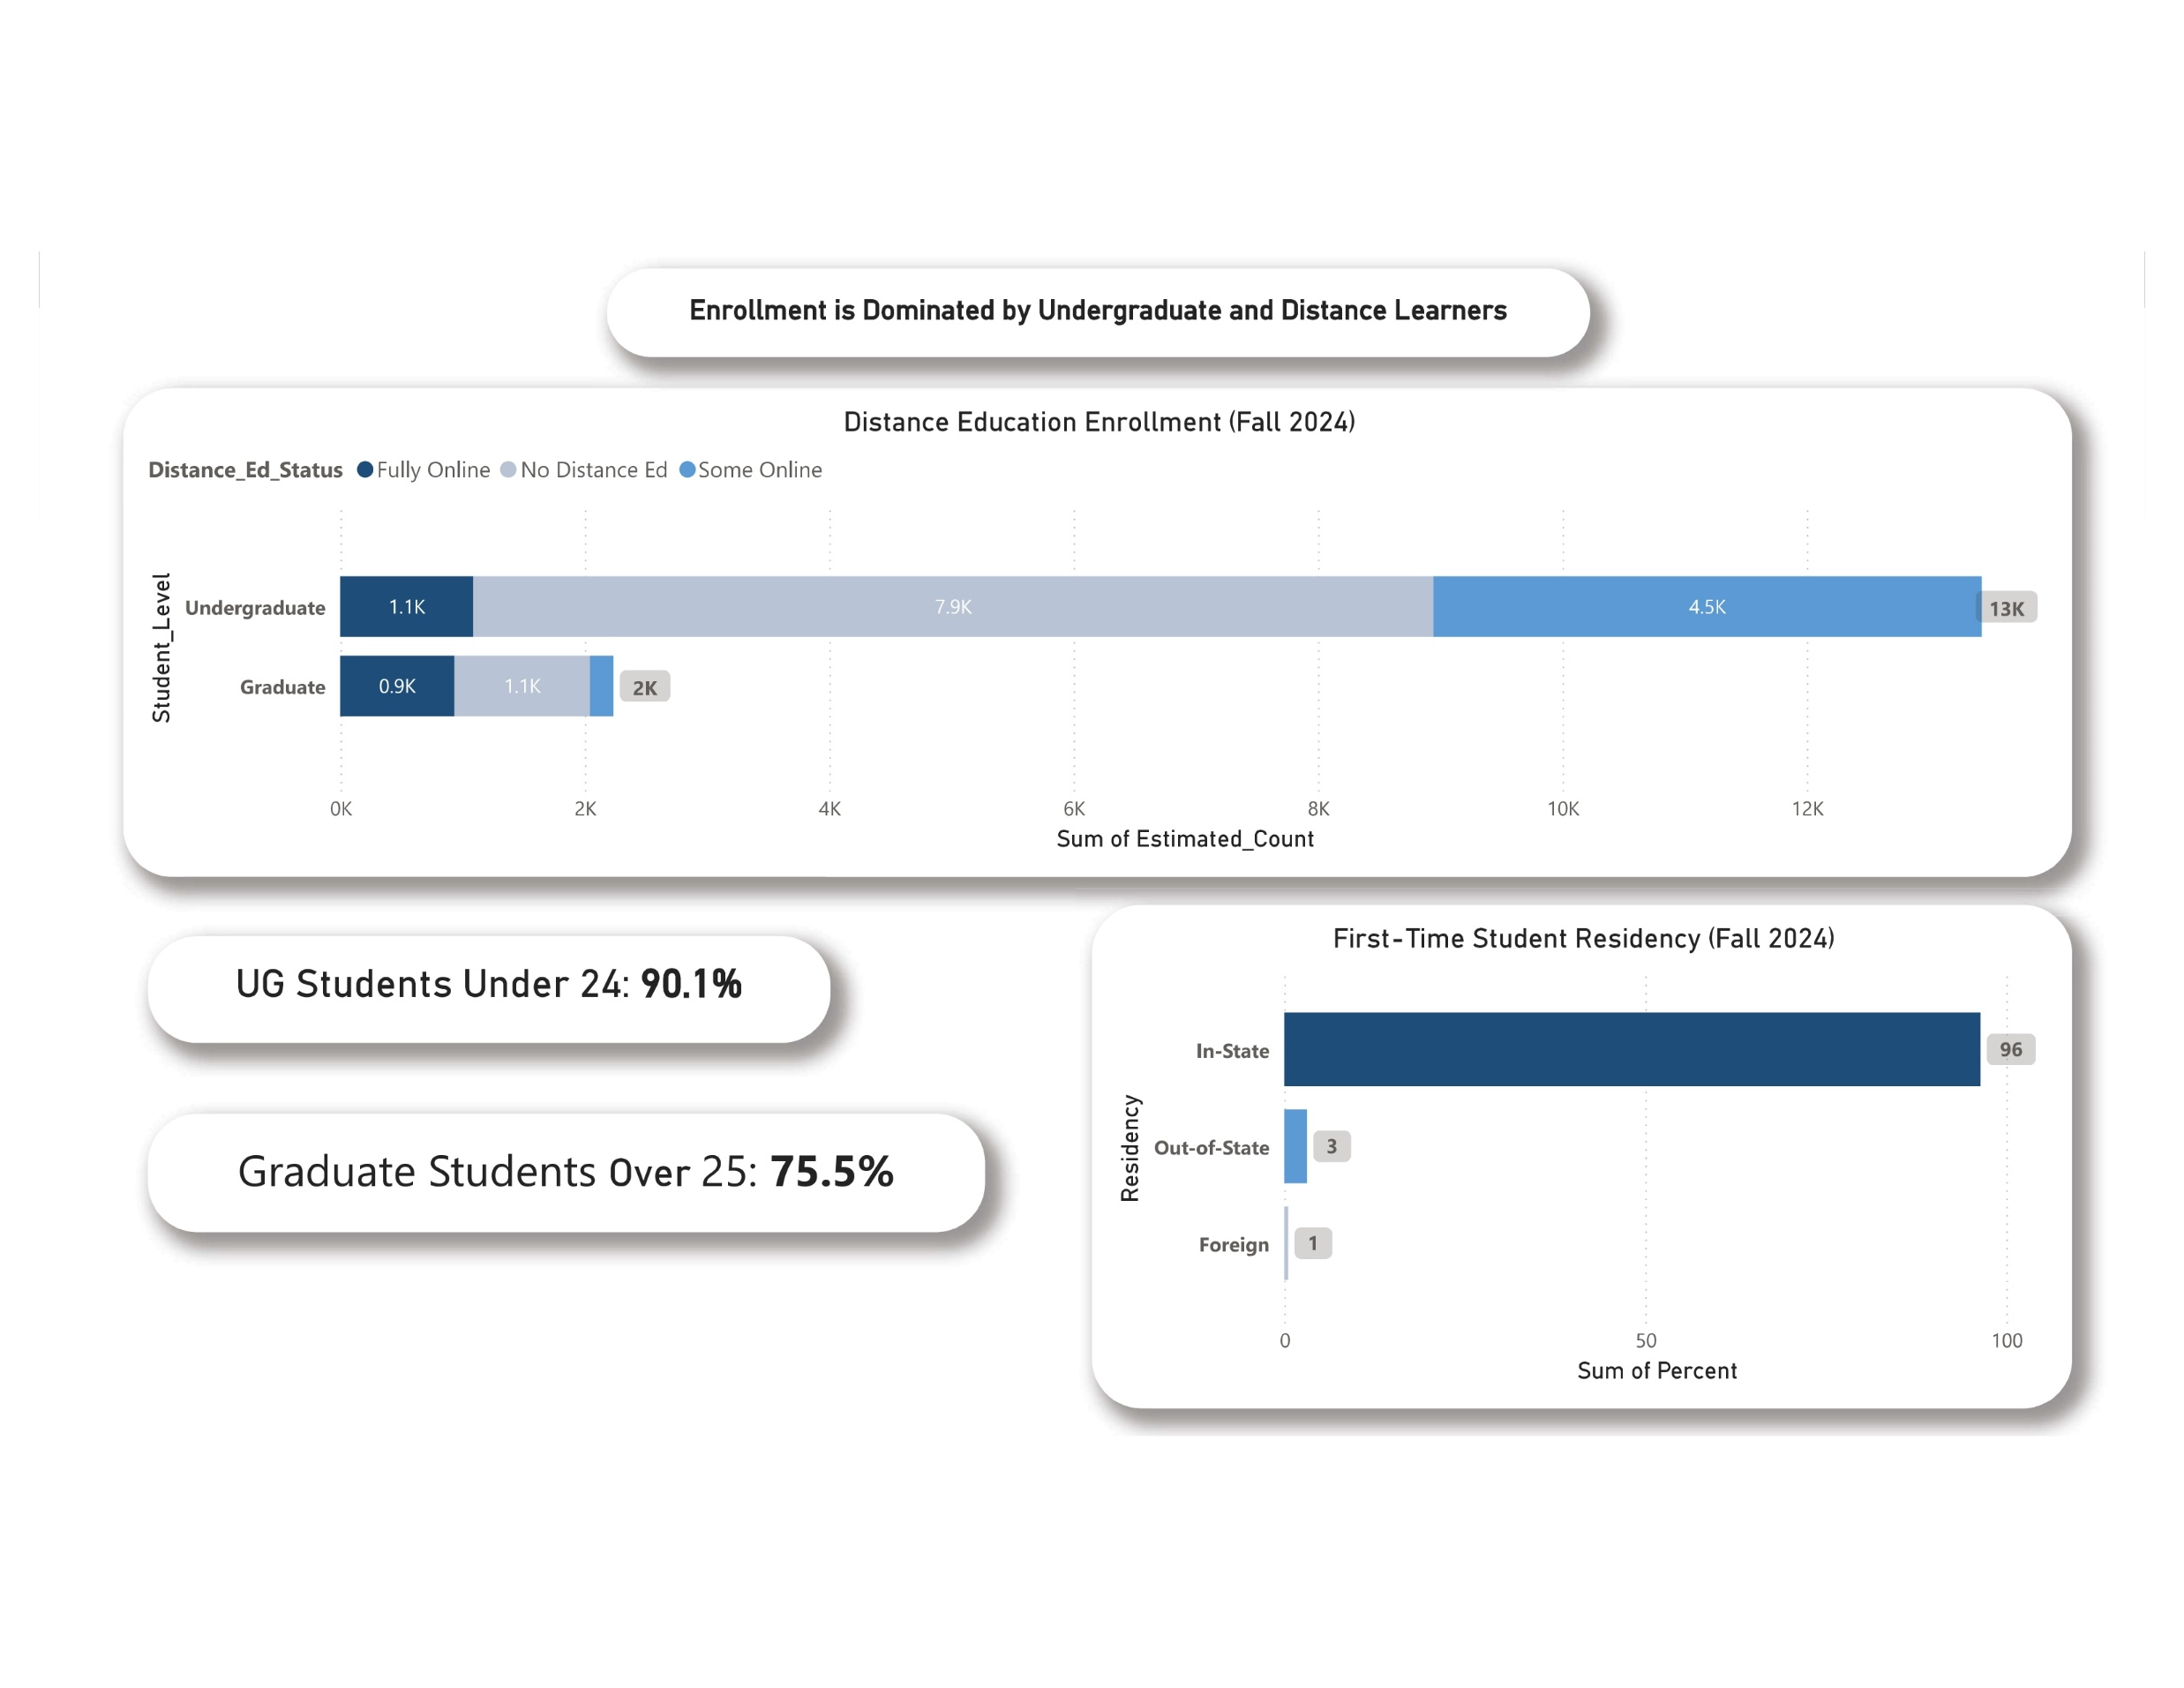
The Dashboard — 4 Pages, One Story
Pages | Title | What It Answers
Page 1 | Executive Overview | How is university performing overall?
Page 2 | Retention & Completion | Are students persisting and graduating?
Page 3 | Equity & Outcomes | Are all student groups succeeding equally?
Page 4 | Enrollment Profile | Who are our students and how are they learning?
Built in Power BI Desktop using IPEDS data — all visuals are live and interactive
Notes:
The dashboard has four pages and each one answers a different question. Page, one gives you the big picture. Page two answers — are students coming back and finishing? Page three answers — are all student groups being served equally? And page four answers — who exactly are our students? Together these four pages tell one connected story. Let me walk you through each one.

Slide 5
16,810 students, one shared goal:
graduation
First-year full-time retention vs. 81% national average. Seven points below benchmark but reflects strong initial student commitment in year one.
Total students enrolled. Graduate and
undergraduate populations combined.
Undergraduate share. Predominantly
undergrad institution with a strong
community pipeline.
Graduation rate vs. 63% national
benchmark. Twelve points below the
national standard.
16,810
84%
74%
51%
Notes:
Here is the big picture. University serves 16,810 students and 84% of them are undergraduates. Now the two numbers I want you to focus on are 74% and 51%. 74% is the percentage of full-time freshmen who came back for their second year. Sounds decent — until you know the national average is 81%. We are 7 points behind. And 51% is the percentage of students who graduate within 6 years. The national average is 63%. We are 12 points behind that too. These are not small gaps. These are hundreds of students every year.

Slide 6
Retention is strong —
graduation is where we lose students
First to Second Year Retention Rate
Graduation rate over time
59% – Women’s graduation rate vs. 46% for men. +13 percentage point gap, indicating a significant gender disparity in completion outcomes.
Part-time students face the steepest barriers — jobs, families, financial pressure. On-time graduation remains rare across all groups.
Notes:
This page shows us who is staying and who is leaving. Full-time students return at 74% — that is manageable. But part-time students? Only 31% come back for year two. That means nearly 7 out of 10 part-time students are gone before their second year. These are typically working adults, parents, people juggling jobs & classes. They are not leaving because they cannot do the work — they are leaving because life gets in the way. The line chart on the right shows graduation over time. Only 25% graduate in 4 years. But by year 6 that number doubles to 51%. So students are not failing — they just need more time and more support. There is also a gender gap worth noting — women graduate at 59%, men at 46%. That is a 13-point difference that deserves attention.

Slide 7
Pell Grant recipients graduate at 44% — 15 points below non-Pell students (59%)
Equity - Not All Students Experience Equal Success
A 51-point gap separates our
highest and lowest graduating
groups
African American students make up 24.9% of enrollment but graduate at just 42%, 11 points below the institutional average—clearly highlighting where additional support is needed.
Notes:
This is the most important slide in the entire presentation. When we say the university has a 53% graduation rate, that number is hiding a very uncomfortable truth. Look at this chart. Depending on a student's background, their chance of graduating ranges from 29% all the way up to 80%. That is a 51-point spread — same university, completely different outcomes. And look at the financials. Students who receive Pell grants — meaning the lowest income students — graduate at 44%. Students with no financial need graduate at 59%. That 15-point gap is not about ability it could be about money, stress, and academic barriers. African American students make up 25% of enrollment but graduate at only 42%. We are enrolling these students and then not supporting them to the finish line.

Slide 8
Student Profile - Most students are young, local, and reachable.
90.1%
Traditional-age undergrads (under 24). Respond well to in-person advising, peer mentoring, and early-alert outreach.
75% of graduate students are over 25.
96%
3.1% out-of-state and 0.5% international students, indicating limited geographic diversity beyond the local region.
In-state first-time students. Strong local ties — our outcomes directly shape regional workforce readiness.
41.8%
8.1% of undergraduates are fully online, showing most still prefer in-person or hybrid learning environments.
Graduate students fully online — indicating strong demand for flexible, remote learning options.
Notes:
This page tells us who our students are. 90% of undergraduates are under 24 — traditional college-age students who respond well to in-person advising and peer support. 96% of first-time students come from in state. That is a strength because it shows deep community roots — but it is also a risk. If state's high school population declines, the university feels it directly. On the online side, 41.8% of graduate students are already fully online. The infrastructure is there. But only 8% of undergraduates are online, which means there is room to grow and reach students who cannot be on campus.

Slide 9
Recommendation
Five targeted actions to close the gap
31% part-time retention | 44% Pell grad rate | 42% AA grad rate | 25% 4-year grad rate | 96% in-state dependency
Dedicated part-time advising + flexible scheduling | Expand emergency aid fund + financial counseling | Culturally responsive advising + early alert system | Accelerated pathways + summer enrollment incentives | Invest in online program expansion + out-of-state recruitment
Increase PT retention toward 50%+ | Close 15-pt financial aid gap | Address 11-pt equity gap | Reduce time-to-degree | Diversify enrollment pipeline
Notes:
Every recommendation on this slide comes directly from the data. Not one of them is a guess. Part-time retention is at 31% — so we need dedicated advising and flexible scheduling for those students. Pell students graduate at 44% — so we need to expand emergency aid and financial counseling. African American students graduate at 42% — so we need culturally responsive support programs and early alert systems to catch struggling students before they disappear. Only 25% graduate in 4 years — so we need accelerated pathways and summer enrollment options. And 96% of students are in-state — so we need to invest in online programs and out-of-state recruitment to protect the pipeline.

Slide 10
"The value of a data culture is not in the charts — it is in what the charts make possible."
What this dashboard enables:
Real-time monitoring of retention and graduation trends
Early identification of at-risk student populations
Evidence-based budget and resource allocation
Accountability reporting to accreditors and state agencies
Year-over-year benchmarking against national peers
Data Source: IPEDS — U.S. Department of Education Tool: Power BI Desktop Cohorts: Fall 2024 Enrollment | Fall 2023 Retention | 2016 & 2018 Graduation Cohorts
Notes:
I want to close with this quote — the value of a data culture is not in the charts; it is in what the charts make possible. What this dashboard makes possible is early action. Instead of finding out at the end of the year that students left, we can identify at-risk students early, allocate resources where they are needed most, and report our progress to accreditors with confidence. Every number you saw today is real, it is public, and it is actionable. Thank you. I am happy to take any questions.

